Slide 1
Welcome...
Kevin stephen biswas(2014-2-60-091)
Rimon Kumar Das(2014-3-60-028)
Md. Rasel Miah (2014-2-60-013)

Slide 2
Our Project...
online food shop

Slide 3
Overview
Introduction
Definition
Features
Working procedure
Future scope
Conclusion

Slide 4
introduction
We have implemented ‘ online food shop’project based on prolog database. It works like other web based shopping projects such as amazon,iFoodbd etc.

Slide 5
features
Can be Ordered of multiple products.
Consumer can see the list of specific type of goods.
A lots of stores within a click away.
Pay easily sitting at home.
So handy.
What can we do using this App?

Slide 6
Working procedure of our project
Run using prolog console.
It will give some options to do something.
Using this options you can see the food list ,you can place order.
To place order you need to input product serial number ,quantity of products.
After this it saves order history of customer in a file

Slide 7
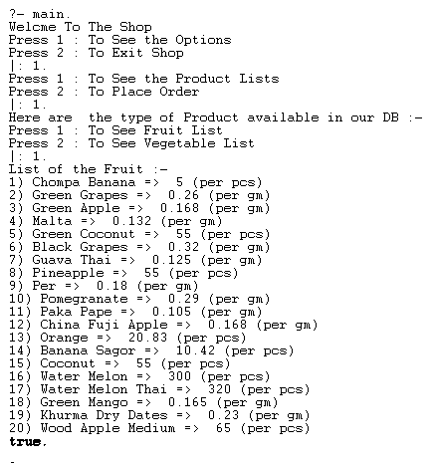
Viewing the food lists

Slide 8
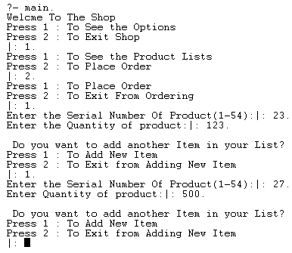
Customer may follow this way to place an order.

Slide 9
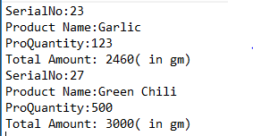
After placing order customer should take this memo

Slide 10
Future Scope
The project made here is just to ensure that this product could be valid in today’s real challenging world.Here all the facilities are made and tested.
Currently it is not visible on virtual world(internet) because of some limitations of project. In future it may be there.
Can be implemented using Big Data.

Slide 11
advantages
You can have goods delivered at your home so no need to leave home.
There is wider variety of goods.
Online shopping gives you privacy.
Easy purchasing.
Which Made easy

Slide 12
disadvantages
Less security of purchasing.
Need internet connection.
Can’t buy with cash.
Errors in billing.

Slide 13
conclusion
To implement this project we used Prolog language . This project simply can be run using prolog console.We tried our best to add some extra features in our project but we can’t because of some limitations.However , this mini project works fine.

Slide 14
Thank you

